Slide 1

Fake News Detectives
Thomas Clemons
Timothy Carter
Gi’Anna Cheairs
Vineet duggi

Slide 2
Agenda
Introduction
Executive Summary
Project Approach
Data Collection, Cleanup and Exploration
Models
Conclusions
Additional Questions
Appendix

Slide 3
The purpose of our project is to mitigate the risk of spreading fake news
Fake news
Can be dangerous

Slide 4
Executive summary
Goal: The aim of our project was to create a tool that could be used to help voters determine whether text is considered ‘real or ‘fake’ news during this election cycle
We identified an appropriate data file, that had over 40,000 articles included, that were fact checked and had been determined to be real or fake
We analyzed data file attributes, cleaned, and broke up the data frames for modeling
We then ran cleaned data files through a variety of classifier models to determine accuracy, precision, sentiment and get a sense of popular, recurring themes
Finally, we created a user input box, that takes in text and makes determinations on realness and sentiment

Slide 5
Project approach
Data File
  Read in CSV files
  Reviewed Data Frame Info
  Reviewed Column Titles & values
Data Preprocessing
  Remove/Rename missing Values
  Classify Data as Real ‘1’ or Fake ‘0’
  Merge 2 Data Frames to 1
  Create Function to Clean Text
  Split Data Frame
Models
  Passive Aggressive Classifier – with TF-IDF Vectorizer
  Word Cloud
  VADER Sentiment
  GRADIO Text Input

Slide 6



Data pre-processing and clean-up
Cleaned up null & bad dates, but there were over 12k, so we dropped dates all together
Added a ‘class’ column to differentiate real vs fake articles
Reviewed ‘real’ and ‘fake’ CSV files columns
Concatenated & Merged to 1 Data Frame including real and fake
Created clean_text function, to remove URLS, numbers, punctuation, etc. Tokenize & rejoin
Verified class totals using value.counts
Added ‘clean_text’ column to Data Frame.
Split Data Frame into 4 parts

Slide 7
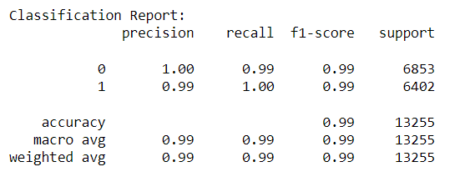

Passive Aggressive Classifier
Read in 4 CSV files & concatenated Data Frame
Dropped additional null rows
Calculated TF-IDF using Vectorizer
Initialized & trained PAC model
Generated Classification Report
Generated a Confusion Matrix to verify PAC accuracy
Saved PAC & TF-IDF models using Pickle for efficiency in future use
Saved split data files for future use if needed

Slide 8

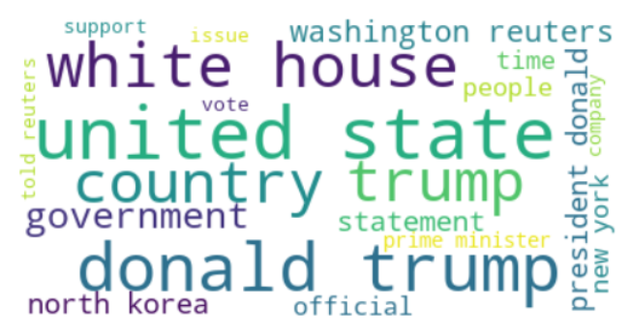
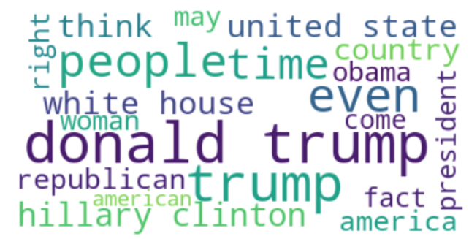
Word Cloud
REAL
Read in 4 CSV files & concatenated Data Frame
Dropped additional null rows
Created smaller Data Frames that dropped all but the 2 columns needed for the word cloud; ‘cleaned_text’ & ‘class’.
Split it into 2 data frames; 1 each for real and fake
Created 2 Word Clouds
Iteratively removed stopwords
FAKE

Slide 9
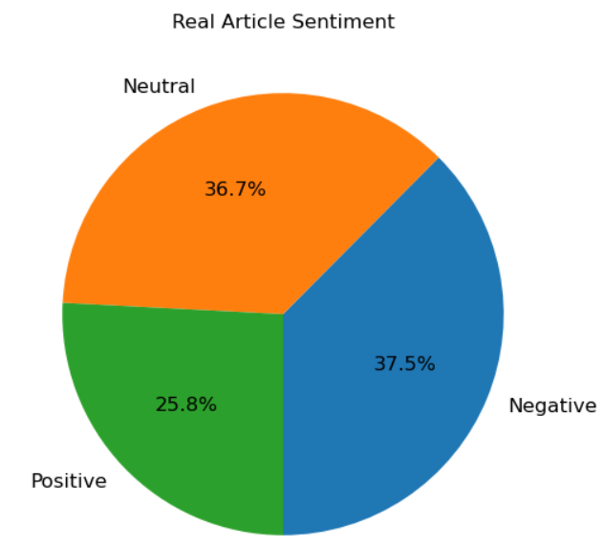
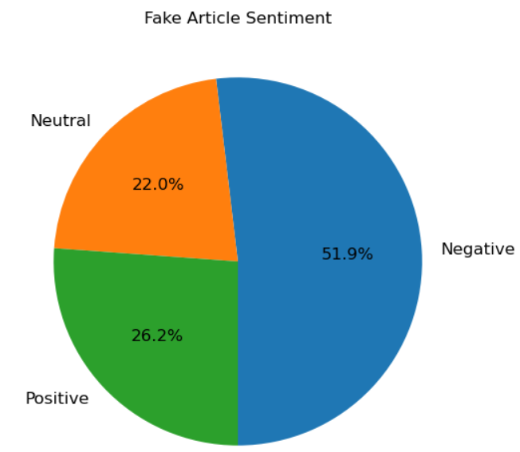
VADER Sentiment Analysis
Takes in sentences and assigns a rating
New import - installed a new Vader library
Created smaller data frame dropping all but 3 cols needed for the word cloud; ‘title’, ‘cleaned_text’ & ‘class’
Created a function that measures the sentiment of a sentence, based on language & tone of the article title
Created a new column for ‘sentiment’ and added column on to the database
Split data frame into 2 and generated sentiment for each

Slide 10
Gradio Classification & WHIsper transcription
New import – installed Hugging Face library
Use pickle to restore models – PAC & TF-IDF
Called ‘clean_text’ function again
Defined ‘article_prediction’ function
  Cleans, vectorizes & then predicts real or fake
Defined ‘get_sentiment_rating’ function
  Assesses sentiment of article (positive, negative or neutral) after we ran it through the clean function
Defined ‘transcribe_text’ function, that uses Whisper to transcribe audio text
Defined function ‘article_sentiment_prediction’
  Calls other functions that we just created
Created Gradio interface that takes text input, calls ‘article_sentiment_prediction’ and produces output indicating sentiment & real vs fake

Slide 11
FINAL TIPS, conclusions & What’s Next?
WHAT’S NEXT?
Applying the model to blogs, tweets & social media
Sentiment analysis of social media posts
If we had better values in the date column, we could have done better analysis on time: time series on sentiment, etc.
Passing more text into Vader Sentiment prediction model will make it lean more negative, as evidenced by our test of ‘article_sentiment_prediction’ vs ‘article_prediction’ functions
Contintuing to iteratively remove stopwords in the Word Cloud model can become cumbersome and eventually counter-productive.

Slide 12
THANK YOU
FAKE NEWS DETECTIVES
Thomas Clemons
Timothy Carter
Gi’Anna Cheairs
Vineet Duggi

